Slide 1


Slide 2
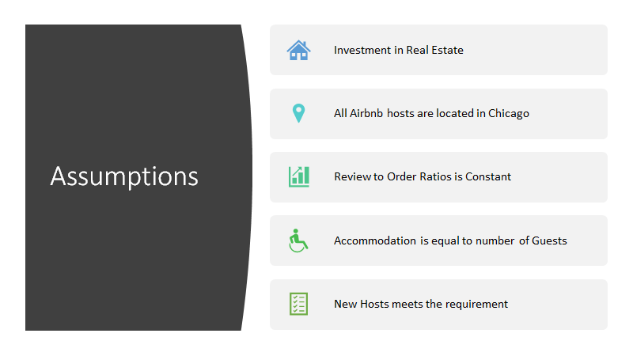
Notes:
Airbnb is a multi sided platform business which connects people that own homes with the people(like travellers, bloggers, backpackers) that want to stay in that homes. Such types of transaction enables people to generate income by utilising their personal assets i.e they maximises the value of one’s personal assets.
By understanding the dataset provided we have concluded that the potential company who wants to know the market share insights of Airbnb must be an Investor Company or a Competitor company. To further analysis our findings we have considered the following Assumptions.
•The company whom we are reporting is planning to invest in real estate in Chicago and wants to rent them on Airbnb.
•All Airbnb hosts in Chicago stated their location as ‘Chicago, Illinois, US’ in the database
•The review to order ratio is constant. It means that the more popular a house is, the more result it gets. Thus, review per month is a reflection of customer per month.
•Accommodation is equal to the number of guests, i.e the number of guests included will fit the capacity of the accommodation. That is, the accommodates will be equal to guests included. Thus, price per person indicates the price level of a property.
•New hosts listed on Airbnb meets the hosting requirement. New host should have a profile picture and are business travel ready (the existing hosts meet the requirements).

Slide 3
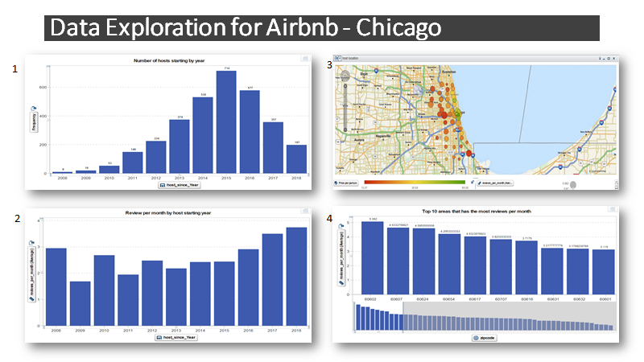
Notes:
Data Exploration for Airbnb – Chicago
•Feasibility of entering Chicago Airbnb Market
Any investor would first like to know whether it is the right time to enter into the market? Also they would like to know whether guests are willing to choose accommodations from new Airbnb hosts? Answer to this question is explained by visualisations – Figure 1 & Figure 2
Figure 1- here we can see that the number of new hosts starting their Airbnb business peaked in 2015 and have kept decreasing since then. But in Figure 2 we can see that although there are fewer hosts entering in Airbnb market, the new hosts got more orders as their review per month are higher. In fact, those hosts started in 2018 received the most order. Thus considering our assumption that reviews per month is the reflection of orders per month, we can understand that there is less entry barrier in the Airbnb Market in Chicago.
•Preferred Areas in Chicago for renting a house
Once it is decided to enter the Chicago Market it is important to understand the area in which property should be purchased & rented to Airbnb. To understand this we will consider Figure 3.
gives the correlation between place (zip code), popularity (reviews per month), and price. The larger bubble suggests a higher average monthly review and a deep green colour suggests a higher average price per accommodate. This figure implies that the places near the city and the lake, where there are many large green bubbles, could be optimal choices for purchasing property.
Figure – 4 shows 10 zip codes, in which the properties have the highest number of monthly reviews. The correlation between hosts’ zip code, average review per month, and price per accommodate. Drawn by selecting zipcode as geography, bubble size as review_per_month and colour as Price per person. Price per person is calculated by using price divided by accommodates and is an indicator of the price level.

Slide 4
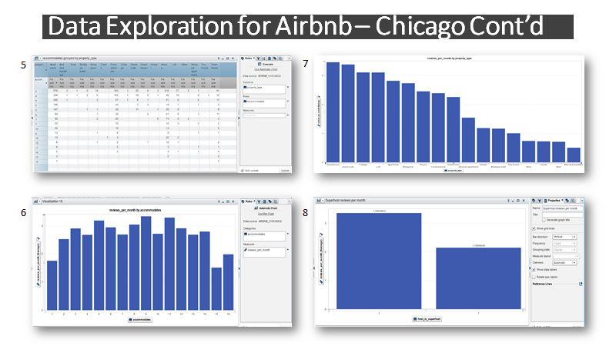
Notes:
•Supply & Demand Side : Accommodates, Property and Room Types Analysis-
Figure 5 shows the distribution of property types and numbers of accommodations in Chicago Airbnb market. It can be seen that the majority types of accommodations available on Airbnb are apartments, condominiums and houses. Also, there is more small-size property (where accommodates <= 4) in Airbnb market. The analysis above gives an understanding of the types of accommodation provides by hosts in Chicago.
After considering supply side lets see the demand side. As per our assumption number of reviews indicates number of orders per month. Figure 6 shows that properties that could accommodate more than four have more reviews per month. This implies that there is higher demand for large-size properties which can accommodate 5 to 14 people. There is insufficient demand for extra-large properties where it can accommodate more than 15 and small or shared properties where capacity is below 2.
Figure 7 indicates the most popular type of properties. The guest houses and guest suite has the most reviews per month, implying that this kind of property is scarce and have insufficient supply.
Thus we can see there is a gap between the supply and the demand for property types and sizes. That is the hosts in Chicago provides many accommodations for less than 4 people, while the number in the guest groups is sometimes greater than 4. Thus, we have an oversupply condition for small accommodation and a shortage for providing larger rentals to guests.
•Super Host Effect – figure 8 shows the average reviews per month made by customers for super hosts are almost 50% higher than that of non-super hosts, indicating that super hosts could attract more customers. Therefore, if a host wants to make more money from Airbnb, he or she would be better to get a super host certification.

Slide 5
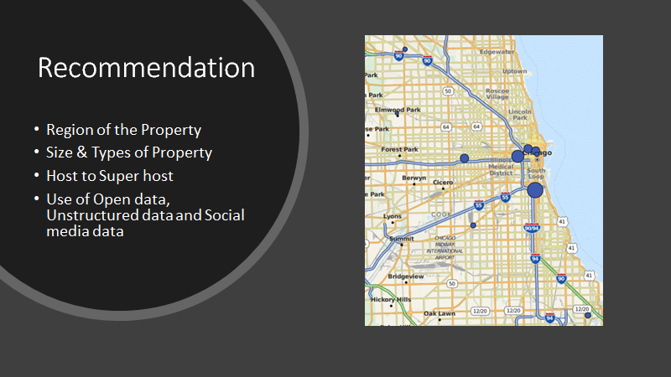
Notes:
•Our first recommendation is the Region of the property. Higher bubble regions in this figure are located near the center part of the city and other 4 regions are located close to a motorway, and one is near a park. Sableman (2018) suggests that Chicago is placed 24th in the United States crime rate in comparison to other cities. Hence, to focus on safety and to reduce the risk of property damaged due to crime, we recommend investing in properties that are located near the center of the city. Also the average nightly stay around the beach per person is $64 compared to $18 - $38.50 around the CBD. Hence, we recommend, if you want to earn more from renting Airbnb, invest in properties near the beach as people are willing to pay more for the view. To be specific, there seems to have a high demand accommodations along the Lake Shore Boulavard between Lee street beach and Greenwood street beach.
•Since we know there is an oversupply for accommodations that can accommodate less number of people (<=4) and a shortage for properties that can accommodate more number (>4) of guests. We recommend that it would be advantageous to invest in properties that can accommodate greater than 4 number of people.
•Host to super host – Host need to improve its operation & maintenance to provide outstanding hospitality service which will help them to gain Super Host certificate
•Use of Open data, Unstructured data and Social media data will help Airbnb to better understand customers needs and preferences which will help them to provide customer centric services , to further enhance their revenues

